Slide 1
Crafting a great 5 minute pitch
Getting your story across to investors

Slide 2
What is an Investor Pitch
You’ve reached that stage where raising finance is key to making the next big step in business growth and you have an opportunity to make a pitch to an investor.
How do you get your message across in a very short space of time? You prepare!
Here is a guide to putting together a powerful and succinct pitch deck that will help you structure your messages – and keep to time!
Use it in conjunction with the ICA pitch deck template.
But remember: The pitch deck is only the beginning. You need to practice, practice and then practice some more!

Slide 3
Suggested structure for a 5 minute pitch
FIVE MINUTES WILL FLY BY!
10-12 slides absolute maximum
30 seconds (on average – some longer some shorter) per slide
NO MORE THAN 5 MINUTES IN TOTAL
Slide layout: more visuals, less text!
A picture paints a thousand words
A GUIDE TO TIMINGS
10 seconds = 23 speaking words
30 seconds = 70 speaking words
60 seconds = 140 speaking words
90 seconds = 180 speaking words

Slide 4
SLIDE 1: INTRODUCTIONS
INTRODUCE YOURSELF AND YOUR COMPANY
Give a high level summary of what your company does:
Should be a simple statement about what change you and your product are making in Zambia (and beyond)
Visuals:
Company logo
Tagline
Product image
Make a powerful opening statement

Slide 5
Slide 2: PROBLEM
DEFINE THE PROBLEM THAT YOU ARE SOLVING
What problem are you solving for your customers?
What does the pain result in?
If you can, make the pain a human problem that everyone can relate to
How many people are affected by this problem?
This is an introduction to your market size…you will cover this in detail later
Visuals
Keywords and images that relate to the problem you are solving
Don’t overcomplicate with too much detail

Slide 6
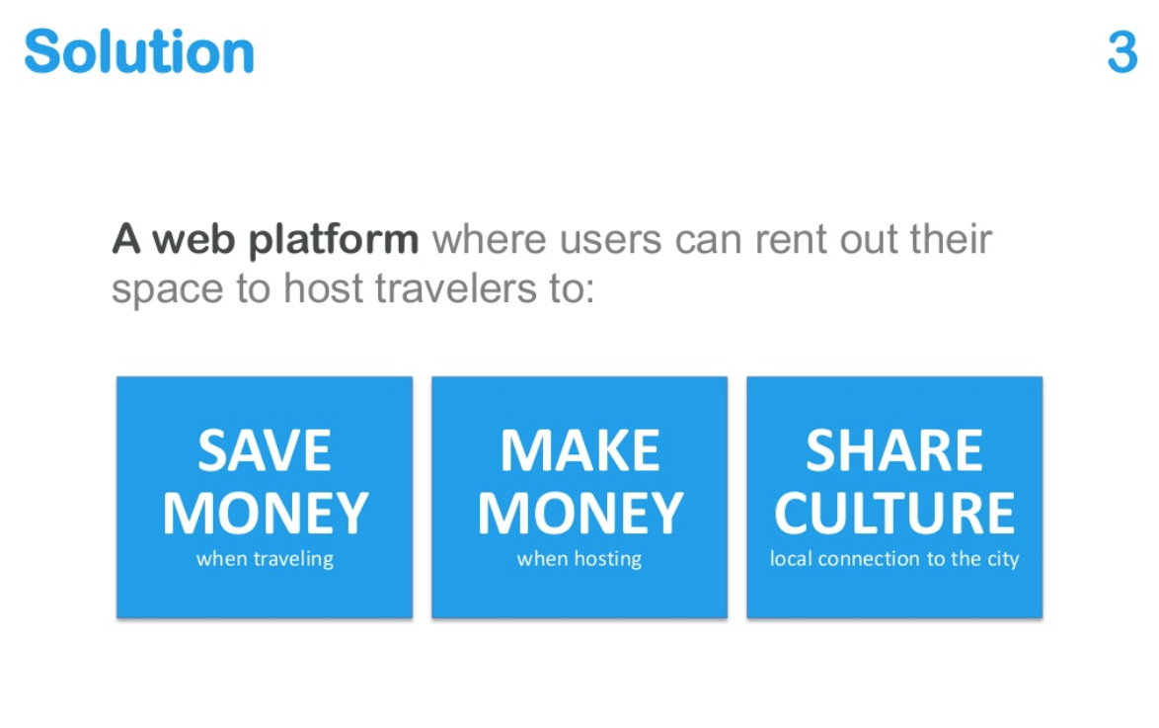
Slide 3: SOLUTION
HOW IS YOUR SOLUTION SOLVING THE PROBLEM?
As simply and briefly as possible, explain what your company does that solves the problem for the customer:
What does your product or service do?
How does it work?
Why is it better, faster, more cost-effective, more efficient, newer, different from alternatives?
Visuals
Visuals of your product and/or service
Don’t flood this slide with bullet points and texts

Slide 7
Slide 4: IMPACT
SUMMARISE YOUR IMPACT STRATEGY
What is the social and/or environmental impact that you deliver with your solution?
How will the investment that you are looking for allow your impact to grow?
Don’t forget to reference the SDGs that relate to your impact strategy.
Visuals
Simple infographic or image plus a compelling graph
Large text with key figures
Check out the “Crafting an impact strategy” guidance notes on the resources section of Impact Starter
Check out the “Are the SDGs relevant to my business” guidance notes on the resources section of Impact Starter

Slide 8
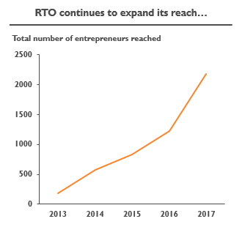
Slide 5: TRACTION
SUCCESS SO FAR
Show that customers are prepared to pay for your solution…highlight your success so far:
How many customers?
How much in sales?
Key milestones achieved
Use data and facts to strengthen your case
Don’t focus on projections (future). Focus on results to date
Visuals
A graph of historical traction and growth
Highlight key metrics that investors should remember
A critical slide for investors Keep it simple, punchy and clear

Slide 9
Slide 6: MARKET OPPORTUNITY
WHAT’S YOUR GROWTH POTENTIAL?
What is the total size of the market and your status within it?
This is where you make investors realise the potential you have to be a real force within your market
How much of that market can you realistically expect to capture?
Visuals
A big number speaks for itself
Show market size and/or growth but make sure to emphasise key numbers
Be truthful! Investors will probe these figures and will remember them

Slide 10
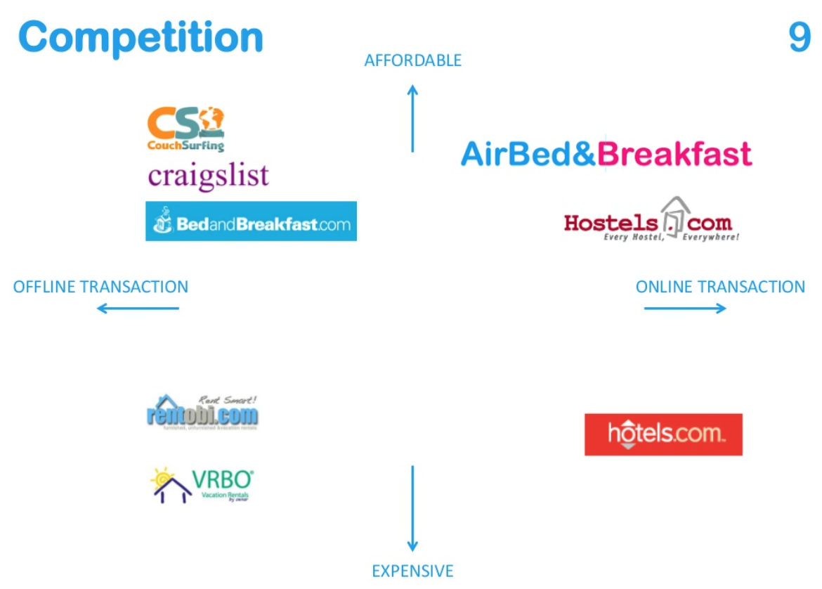
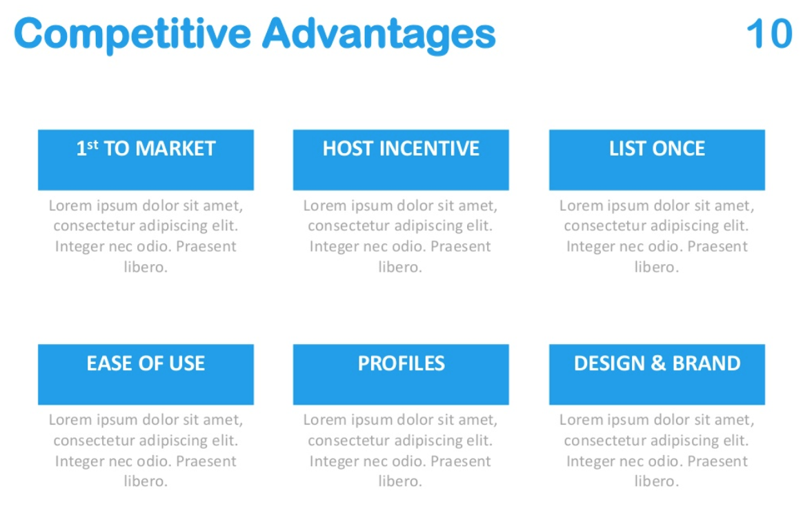
Slide 7: COMPETITIVE EDGE
WHAT’S YOUR SECRET SAUCE?
There will be competitors. So what is it that makes you different and better?
Focus on YOUR company
Don’t spend time talking about competitors
What is specific or unique to your business?
Technology / relationships / partnerships?
How do you help your customers get results differently?
Show you have researched the market and know what the competition is
Visuals
Visualise the key components that differentiate your product or use a very brief and snappy table to show the competitive landscape

Slide 11
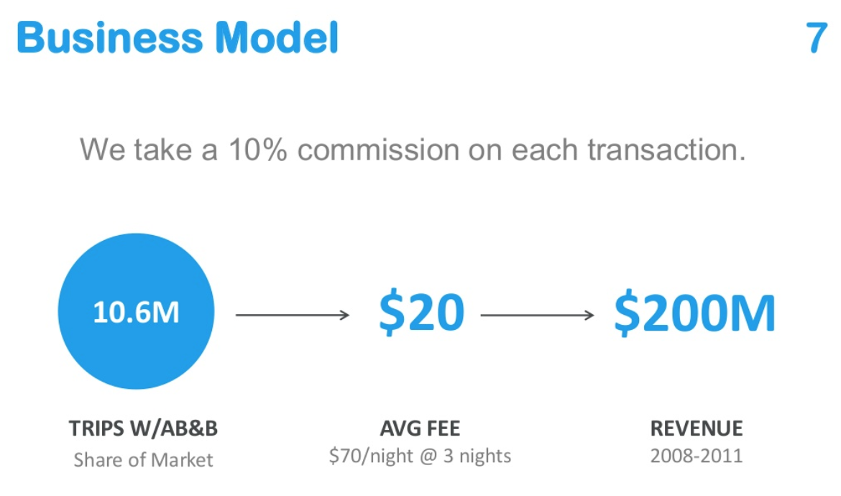
Slide 8: BUSINESS MODEL
SUMMING UP YOUR BUSINESS APPROACH
How do you earn money?
What is the opportunity for growth?
How can you scale beyond your current scope?
New markets and territories?
New products or range extension?
Partnerships and technology?
Visuals
If possible, represent graphically
You might like to look at something like the business model canvas for structure
https://diytoolkit.org/tools/business-model-canvas/

Slide 12
Slide 9: TEAM
WHY ARE YOU THE RIGHT TEAM FOR SUCCESS
Above all else, people invest in teams. Use this opportunity to showcase your background and that of other key team members
Highlight relevant experience and impressive past accomplishments
Make a case for why you are a winning team
Outline your structure if you can, include titles and high-level role descriptions
Visuals
Headshots
Impressive statistics

Slide 13
Slide 10: INVESTMENT
HOW MUCH ARE YOU LOOKING FOR?
Have you raised money before?
How much are you looking to raise now?
What stage round is this?
What big next steps will you be able to take with the benefit of this investment?
What milestones will you reach?
What type of instrument are you looking for e.g. debt, equity, mezzanine etc
What expectations do you have of investors? E.g. experience, networks, expertise?
What exit possibilities exist – if you have an idea of what they might be
Visuals
Graphs/infographics
Highlight key figures and important text
A critical slide for investors Keep it simple and direct

Slide 14
Slide 11: CALL TO ACTION
WHY INVESTORS SHOULD INVEST IN YOU
Make a compelling summary for why investing in your company in this round
Why now is the right time to raise capital and grow fast
You don’t have to call this slide “Call to action”
It should be something that highlights why investors should invest with you. E.g. “Invest in smallholder farmers, and change the world from the bottom up”
Visuals
Image or graphics work well

Slide 15
Slide 11: SUMMARY
WHAT 3 -4 POINTS DO YOU WANT INVESTORS TO REMEMBER?
You have presented a lot of information in a short period of time
To finish your pitch, drive home the 3-4 key points you want the investors to keep thinking about
Impact strategy is a must
Visuals
Bullet points/infographics
DON’T FORGET TO SAY THANK YOU!

